Slide 1
FPGA Summer Training
Speaker: Chia-Chen Yen (嚴家成)
2020-08-17

Slide 2
Learning Goal
  PYNQ-Z2 Hardware/FPGA Architectures
Verilog Basics
  logic design (simple circuit/full adder/reconfigurable LUT)
  verilog implementation
  creating & packaging custom IP (intellectual property)
Block Design
PYNQ Overlay
  accessing custom IP via PYNQ

Slide 3
  PYNQ-Z2 Hardware
Zynq® devices: a class of All Programmable Systems on Chip (APSoC)
  PS (Processing System): ARM SoC
  PL (Programmable Logic): FPGA
PYNQ (Python Productivity for Zynq): an open-source project that makes it easier to use Xilinx platforms by the Python language and libraries.
  Jupyter Notebook: an interactive computing environment which is embedded in Zynq SoC

Slide 4
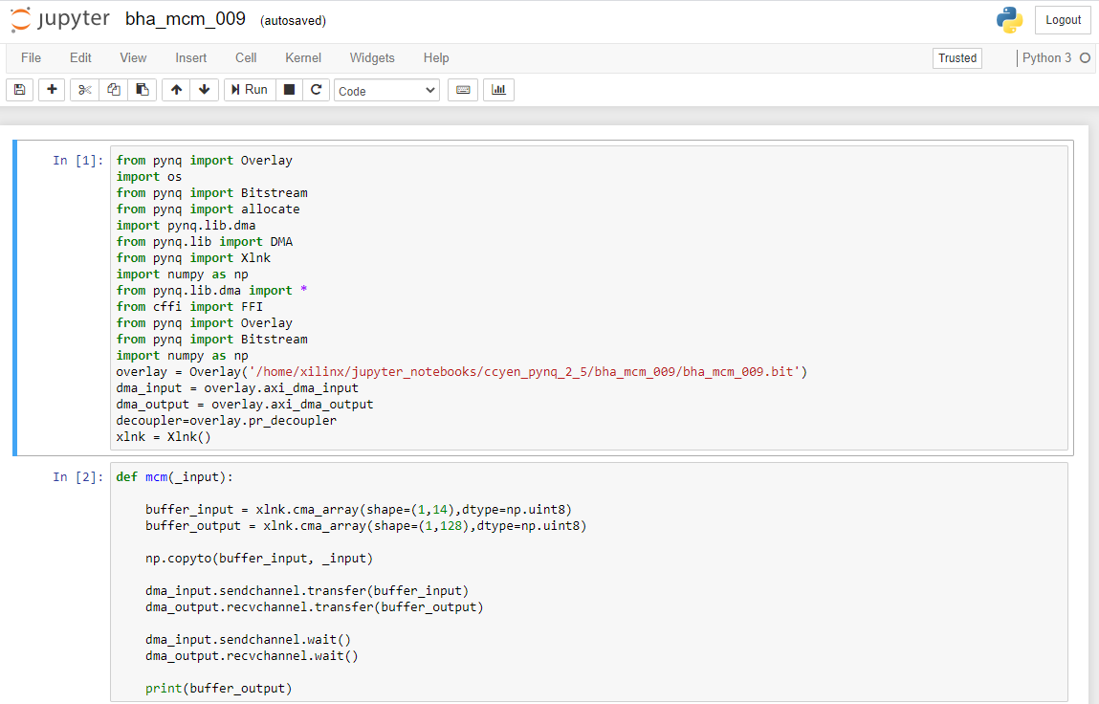
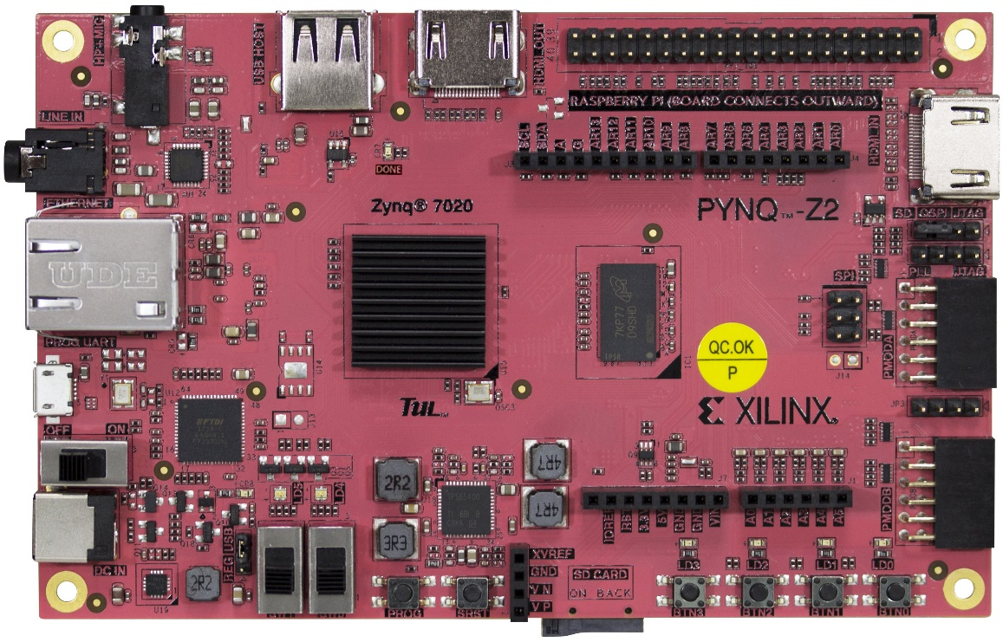
  PYNQ-Z2 Hardware
APSoC
PS/PL

Slide 5
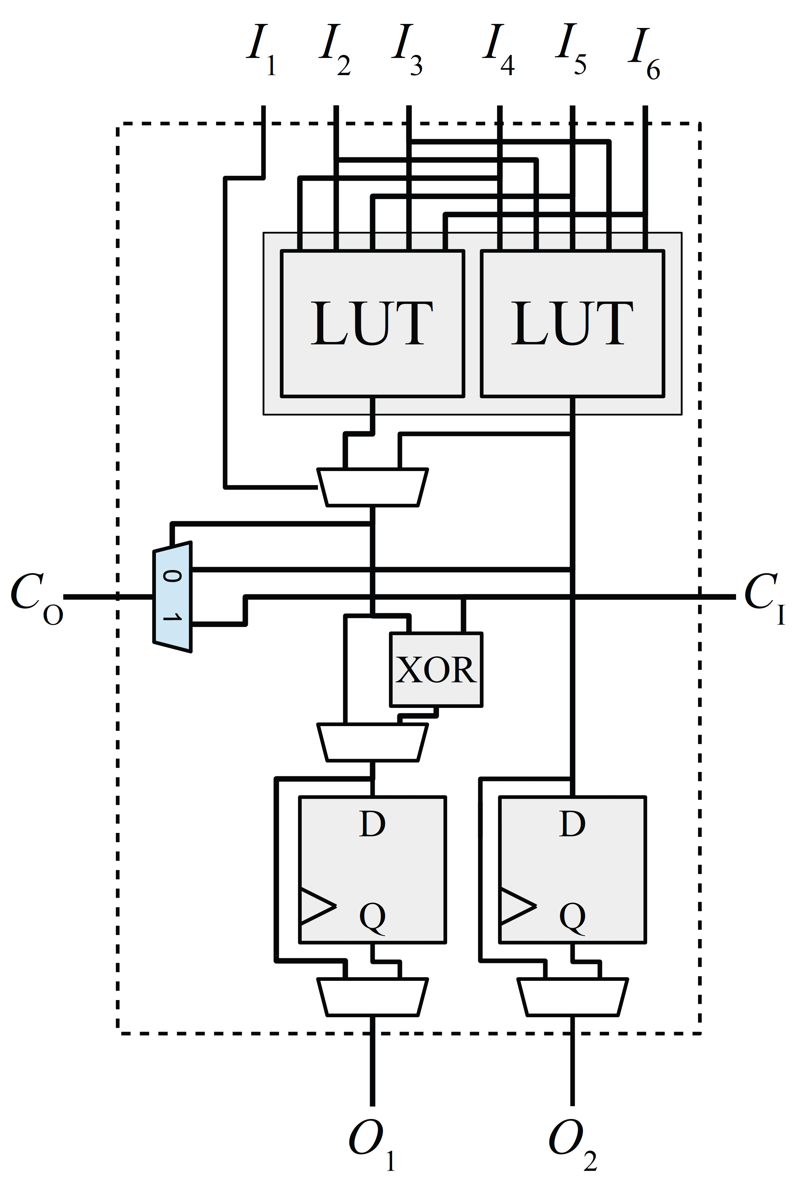
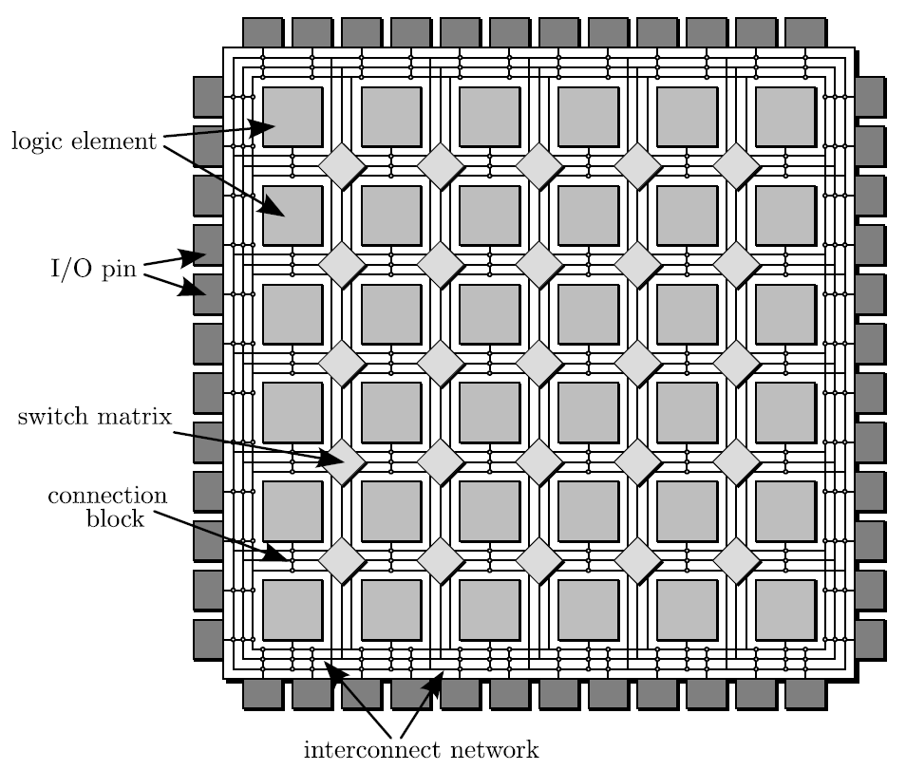
FPGA Architectures: An Overview
Basic Logic Element (BLE)
look-up table (LUT)
(LE)
carry-chain logic (RC adder)
D-type flip flop

Slide 6
FPGA Architectures: An Overview
Basic logic element (BLE)
  The bitstream of a netlist contains information as to which SRAM bit of an FPGA be programmed to 0 or to 1.

Slide 7
FPGA Architectures: An Overview
Switch Block
  The routing information of a netlist is used to correctly program the SRAM bits of connection boxes and switch boxes.
SRAM

Slide 8
Verilog Basics
System Level: System C
RTL Level (Register Transfer Level)
  Dataflow Level
    assign out1 = in1 & in2;
  Behavior Level
    always @(w_io) begin
    out1 = in1 & in2;
    end
Gate Level: and/or/not/xor
      and and1(out1,in1,in2);
      myModule myModule_inst(.port1(w1_io),.port2(w1_io));
Transistor (Switch) Level

Slide 9
Verilog Basics: Simple Logic Circuit
Block Diagram
top_simple_circuit.v
regslice_core.v
AXI DMA Interconnect input_r_TDATA [7:0]
AXI DMA Interconnect output_r_TDATA [7:0]
I1
I2
Onot
Oand
Oor
ip_simple_circuit.v

Slide 10
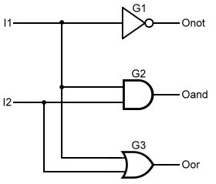
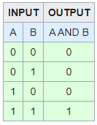
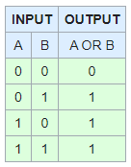
Verilog Basics: Simple Logic Circuit
Gate Level
module ip_simple_circuit (I1, I2, Onot, Oand, Oor);
input I1, I2;
output Onot, Oand, Oor;
not G1(Onot, I1);
and G2(Oand, I1, I2);
or G3(Oor, I1, I2);
endmodule
primitives
assign Onot = !I1;
assign Oand = I1 && I2;
assign Oor = I1 || I2;
Truth Table
I2 | I1 | Onot | Oand | Oor
0 | 0 | 1 | 0 | 0
0 | 1 | 0 | 0 | 1
1 | 0 | 1 | 0 | 1
1 | 1 | 0 | 1 | 1

Slide 11
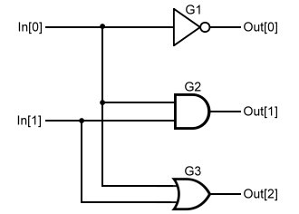
Verilog Basics: Simple Logic Circuit
Gate Level
module ip_simple_circuit (I1, I2, Onot, Oand, Oor);
input [1:0] In;
output [2:0] Out;
not G1(Out[0], In[0]);
and G2(Out[1], In[0], In[1]);
or G3(Out[2], In[0], In[1]);
endmodule
vector
Truth Table
I2 | I1 | Onot | Oand | Oor
0 | 0 | 1 | 0 | 0
0 | 1 | 0 | 0 | 1
1 | 0 | 1 | 0 | 1
1 | 1 | 0 | 1 | 1

Slide 12
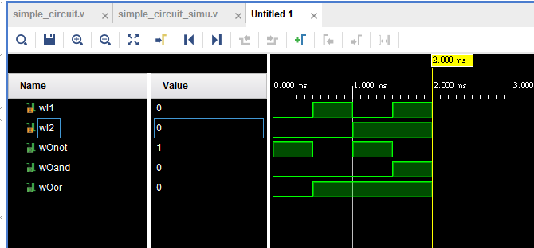
Verilog Basics: Simple Logic Circuit
Simulation Result

Slide 13
Verilog Basics: Full Adder
Block Diagram
top_full_adder.v
regslice_core.v
AXI DMA Interconnect input_r_TDATA [31:0]
AXI DMA Interconnect output_r_TDATA [31:0]
inA
inB
out
ip_full_adder.v
one_full_adder.v x 4

Slide 14
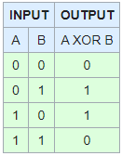
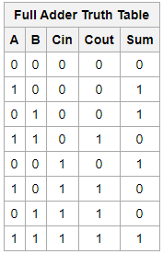
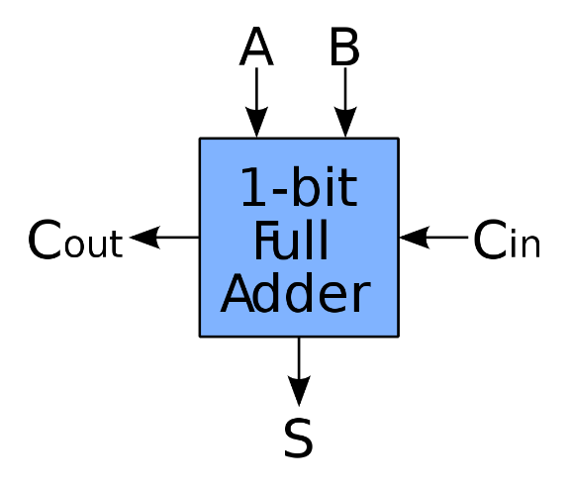
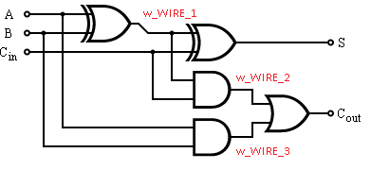
Verilog Basics: Full Adder
1-bit Full-Adder

Slide 15
Verilog Basics: Full Adder
module one_full_adder (i_bit1, i_bit2, i_carry, o_sum, o_carry);
input i_bit1;
input i_bit2;
input i_carry;
output o_sum;
output o_carry;
wire w_WIRE_1;
wire w_WIRE_2;
wire w_WIRE_3;
assign w_WIRE_1 = i_bit1 ^ i_bit2;
assign w_WIRE_2 = w_WIRE_1 & i_carry;
assign w_WIRE_3 = i_bit1 & i_bit2;
assign o_sum = w_WIRE_1 ^ i_carry;
assign o_carry = w_WIRE_2 | w_WIRE_3;
endmodule
i_bit1
i_bit2
o_sum
i_carry
o_carry

Slide 16
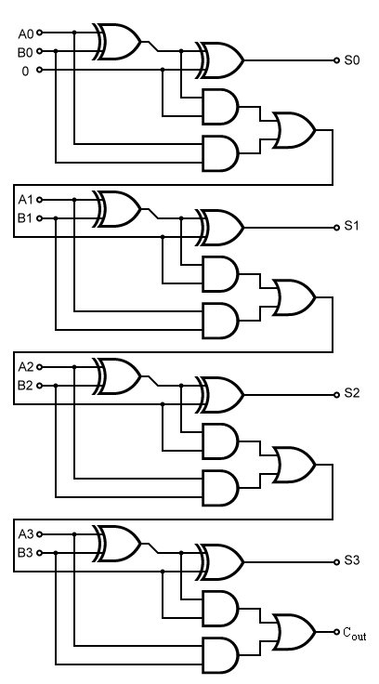
Verilog Basics: Full Adder
module ip_full_adder (inA, inB, out);
input [3:0] inA;
input [3:0] inB;
output [3:0] out;
wire [3:0] w_io;
full_adder_1_bit fa_0(.i_bit1(inA[0]), .i_bit2(inB[0]), .i_carry(0), .o_sum(out[0]), .o_carry(w_io[0]));
full_adder_1_bit fa_1(.i_bit1(inA[1]), .i_bit2(inB[1]), .i_carry(w_io[0]), .o_sum(out[1]), .o_carry(w_io[1]));
full_adder_1_bit fa_2(.i_bit1(inA[2]), .i_bit2(inB[2]), .i_carry(w_io[1]), .o_sum(out[2]), .o_carry(w_io[2]));
full_adder_1_bit fa_3(.i_bit1(inA[3]), .i_bit2(inB[3]), .i_carry(w_io[2]), .o_sum(out[3]), .o_carry(w_io[3]));
endmodule

Slide 17
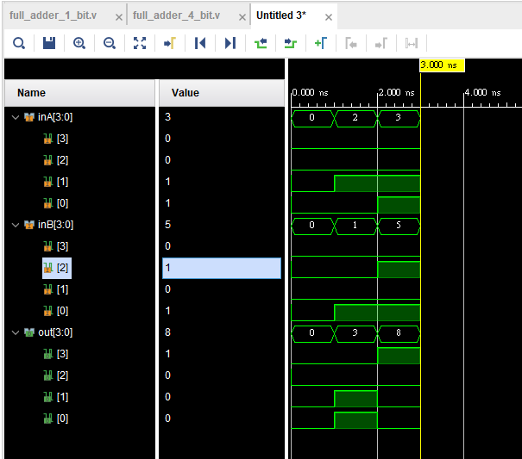
Verilog Basics: Full Adder
Simulation Result

Slide 18
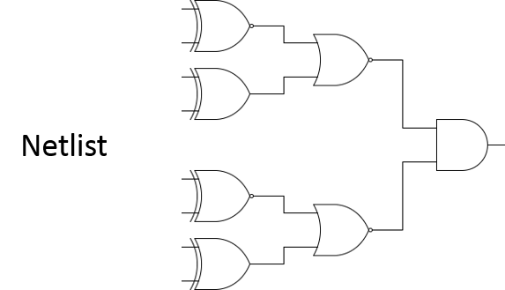
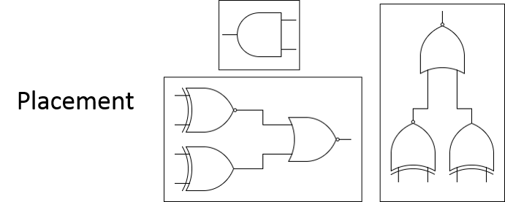
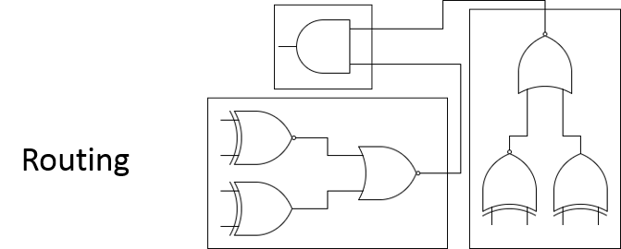
HDL-based FPGA Design Flow on Vivado
Design Specification
HDL (Hardware Description Language) Implementation
  Simulation (testbench)
Synthesis: HDL >> netlist.v (gate-level)
  the process of transforming an RTL-specified design into a gate-level representation
Implementation
  all steps necessary to place and route the netlist onto the FPGA device resources
Bitstream Generation
  bitstream file

Slide 19
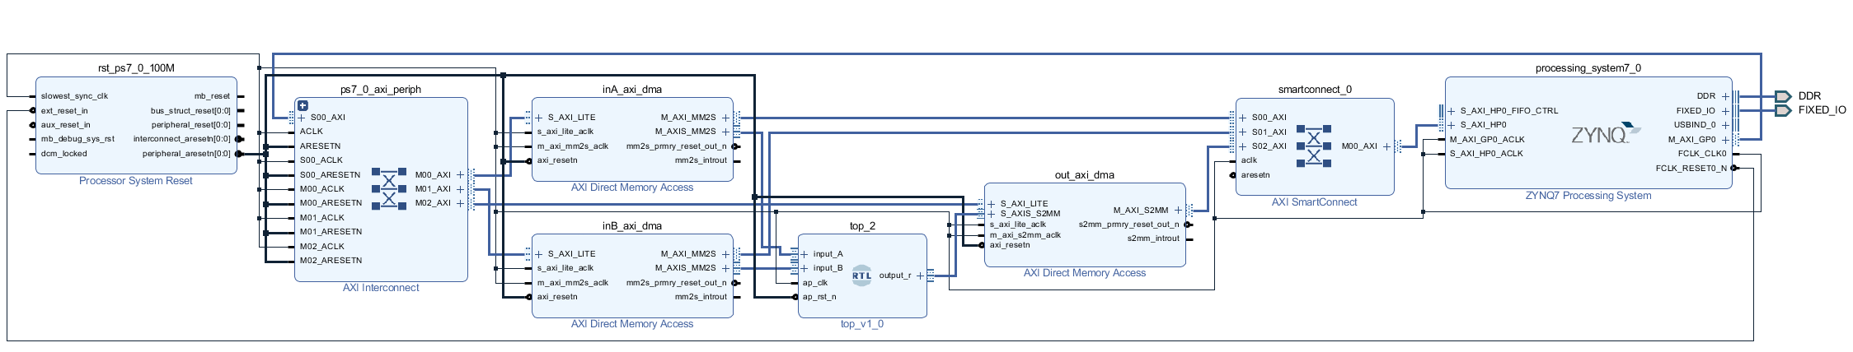
HDL-based FPGA Design Flow on Vivado: Block Design
DMA IP provides high-bandwidth direct memory access between memory and AXI4-Stream-type target peripherals
AXI Interconnect IP connects one or more AXI memory-mapped master devices to one or more memory-mapped slave devices
custom IP
AXI SmartConnect IP is the successor to AXI Interconnect with a different IP technology

Slide 20
HDL-based FPGA Design Flow on Vivado: AXI Interface
Transaction: transfer of data from one point in the hardware to another point
Initiates the transaction
Responds to the initiated transaction

Slide 21
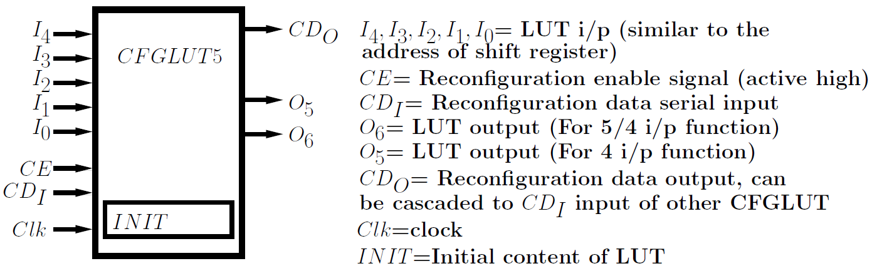
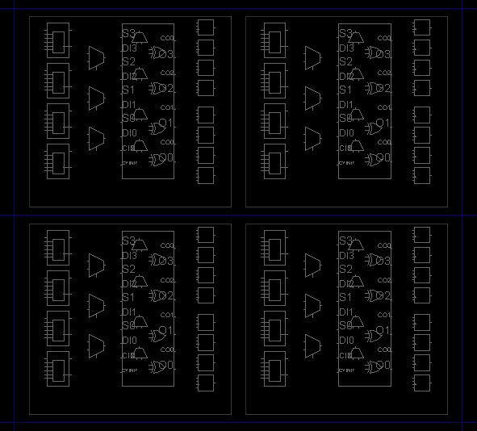
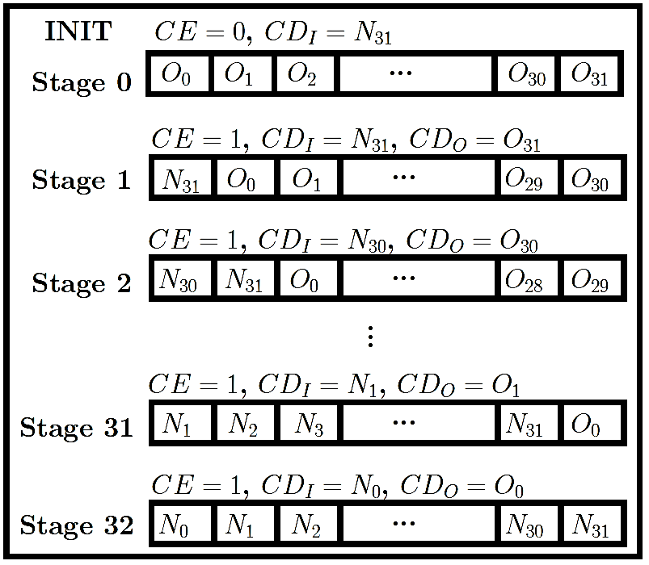
Verilog Basics: Reconfigurable LUT (CFGLUT5)
Reconfigurable LUT
CLB (configurable logic block)
CLB 1
Slice-L
Slice-M
CLB 2
Slice-L
Slice-M

Slide 22
Verilog Basics: Reconfigurable LUT (CFGLUT5)
CFGLUT5 #(
.INIT(32'hxxxxxxxx), // Initial logic function
.IS_CLK_INVERTED(1'b0) // Optional inversion for CLK
)
CFGLUT5_INST (
.CDO(CDO), // 1-bit output: Reconfiguration cascade
.O5(xx), // 1-bit output: 4-LUT
.O6(xx), // 1-bit output: 5-LUT
.CDI(CDI), // 1-bit input: Reconfiguration data
.CE(CE), // 1-bit input: Reconfiguration enable
.CLK(CLK), // 1-bit input: Clock
// LUT Inputs: 1-bit (each) input: Logic inputs
.I0(xx),
.I1(xx),
.I2(xx),
.I3(xx),
.I4(xx)
);

Slide 23
Verilog Basics: Reconfigurable LUT (CFGLUT5)
AXI DMA Interconnect input_c0
CE
Timer-Trigger
AXI DMA Interconnect input_c1 [31:0]
[31]
[4]
[3]
[2]
[1]
[0]
31 | … | 4 | 3 | 2 | 1 | 0
CDI
ap_clk
AXI DMA Interconnect input_d [15:0]
ip_cfglut5_2_bit.v
regslice_core.v
[4]
[3]
[2]
[1]
[0]
I4
I3
I2
I1
I0
[9]
[8]
[7]
[6]
[5]
I4
I3
I2
I1
I0
31 | … | 4 | 3 | 2 | 1 | 0
31 | … | 4 | 3 | 2 | 1 | 0
CDO
CFGLUT5_0
CFGLUT5_1
CDI
O6 O5
O6 O5
AXI DMA Interconnect output_d [7:0]
top_cfglut5_2_bit.v
[0] [x]
[1] [x]

Slide 24
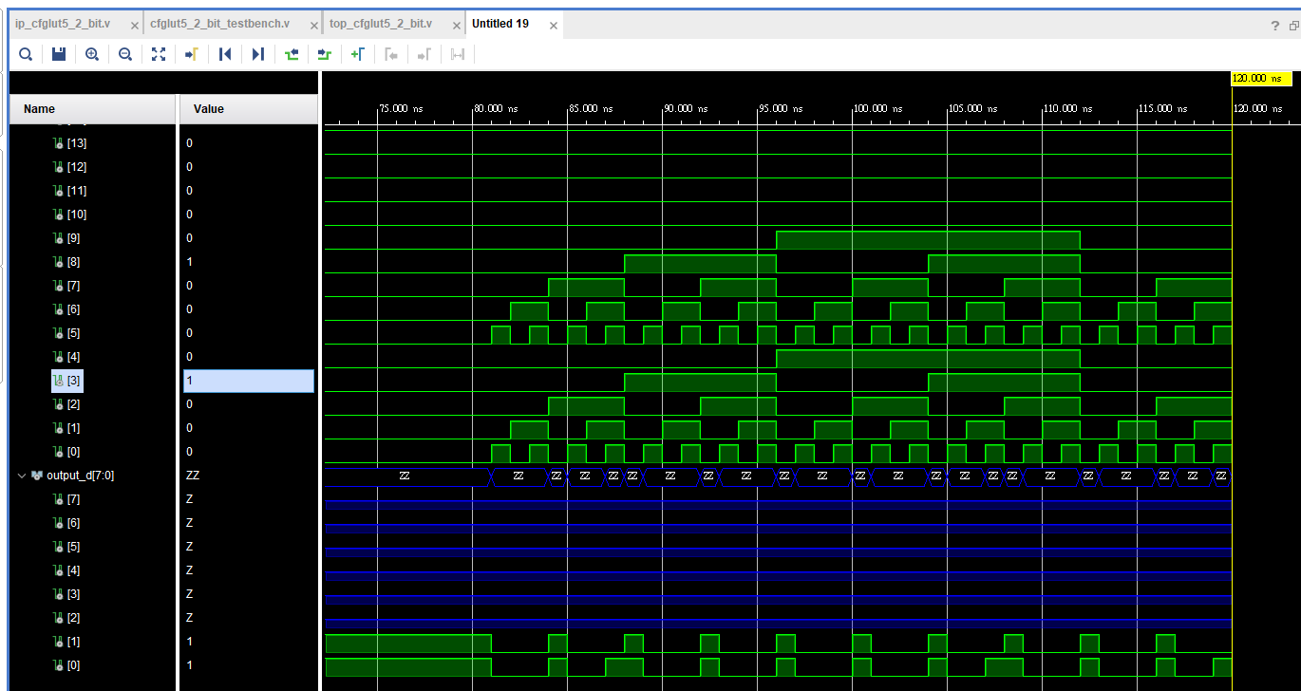
Verilog Basics: Reconfigurable LUT (CFGLUT5)
Simulation Result

Slide 25
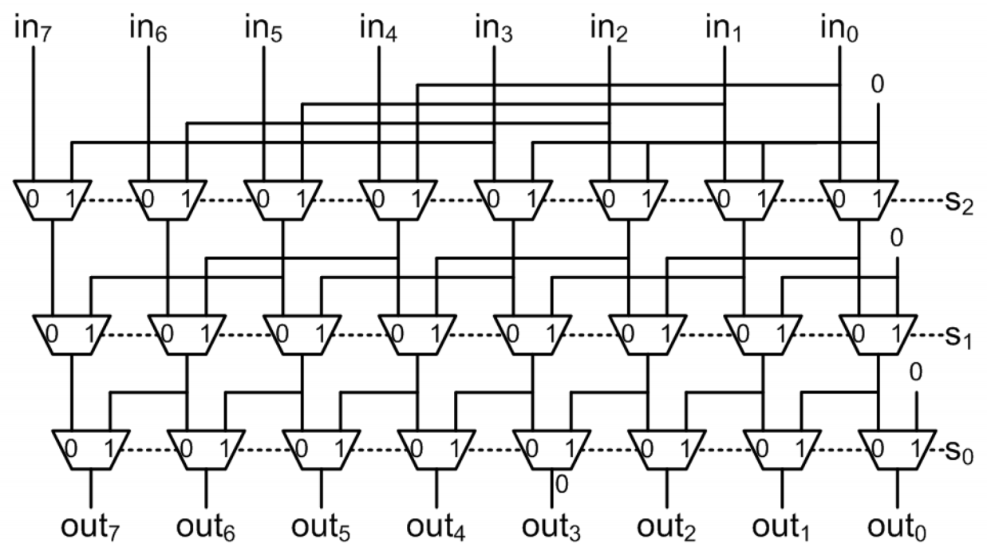
QUIZ…
8-bit log shifter

Slide 26
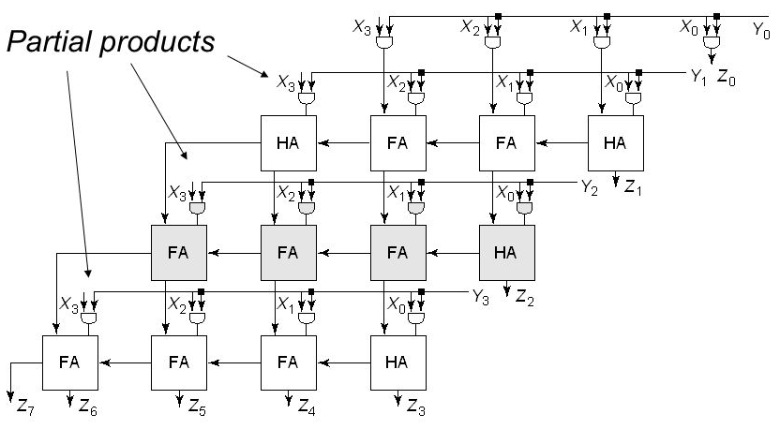
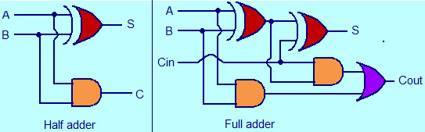
QUIZ…
4-bit array multiplier
0000001010
X000001011
0000001010
000001010
00000000
0001010
0001101110
X_{B}
multiplicand
1
0
1
0
Y_{B}
multiplier
1
1
0
1
0
1
0
partial products
1
0
1
0
0
Z_{B}
result
1
1
0
1
0
1
1
0
1
1
0
1

Slide 27
Thank you for your attention

